Slide 1

Quantum Computing with Qiskit : Phase II Updates
Pawel Pratyush
Vrushali Shinde
Date: 04 - 18 - 2023

Slide 2
Tools and Technology Used
Before
After
Hardware
8.0 GB RAM (2666 MHz)
Intel Core i5 4.10 GHz (4 cores)
Software:
Qiskit Terra: 0.23.2
Qiskit Aer: 0.12.0
Numpy:1.21.5
Python: 3.9.13
OS: Windows 11 Home (64-bit)
Hardware
320 GB RAM
Intel Xeon(R) Silver 4216 CPU
2.10 GHz (32 cores)
16 GB NVIDIA RTX 5000
Software:
Qiskit Terra: 0.23.2
Qiskit Aer: 0.12.0
Numpy:1.21.5
Python: 3.9.13
OS: Ubuntu Debian 20.04.6 LTS

Slide 3
Experimental setup
Quantum Simulator: QASM
Problem Sizes:
Min = 2 qubits
Max = Indefinite
Performance metrics: Execution time in each iteration (in sec)
Memory allocated in each iteration (in MB)

Slide 4
Simulator
The algorithms are executed using qasm simulator as backend.
Other qiskit simulator like unitary or statevector do not perform measurements and are better suited for intermediate simulation behavior analysis
Pulse simulator is used for simulation of behavior of superconducting qubits. i.e. ones with current and voltage.
We have doubled the number of shots!
Hence, Aer.get_backend('qasm_simulator')

Slide 5
Time and Memory
Before
After
timeit()
We want to measure the execution time for repetitive block of code for different qubits
Other time imports mostly focus on overall execution
tracemalloc()
Simple to read
Start and stop as per the block of code we want
time()
Less parameters.
Simple to implement
We are excluding the time taken to build the circuit. Only time for simulation!
tracemalloc()
Simple to read
Start and stop as per the block of code we want

Slide 6
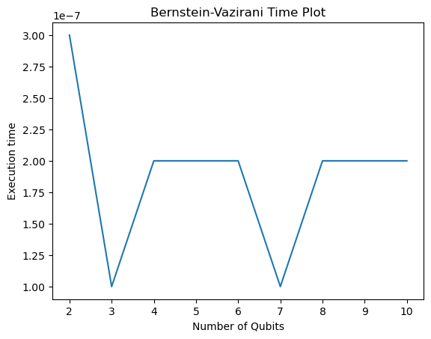
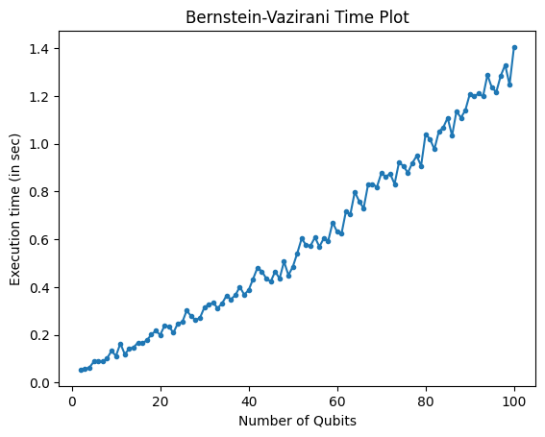
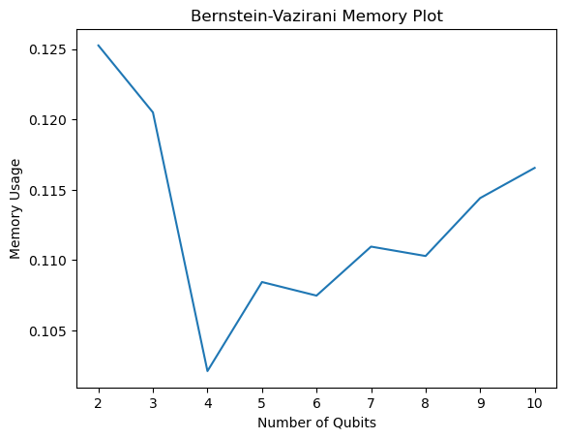
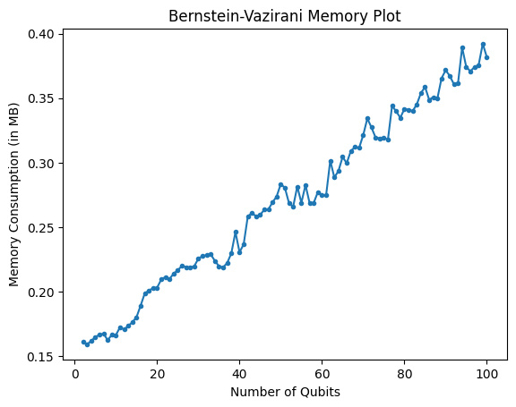
Bernstein-Vazirani Plots
Corrections

Slide 7
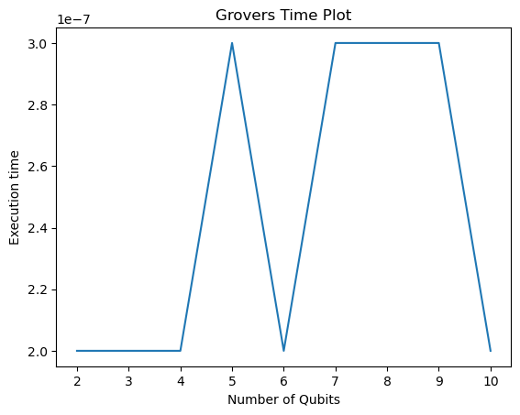
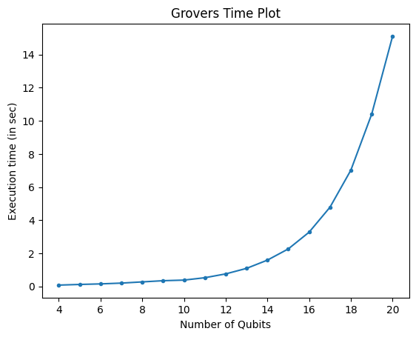
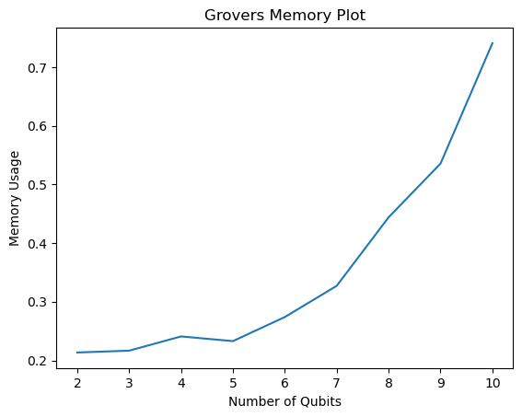
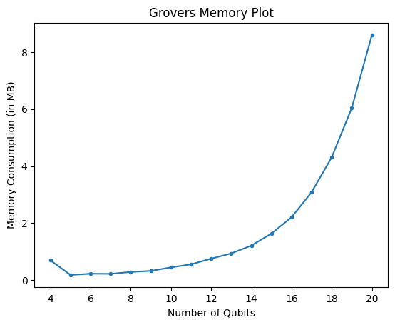
Grover’s Plots
Corrections

Slide 8
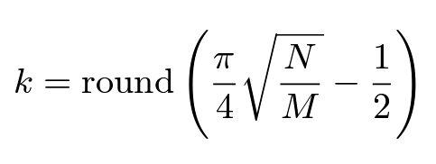
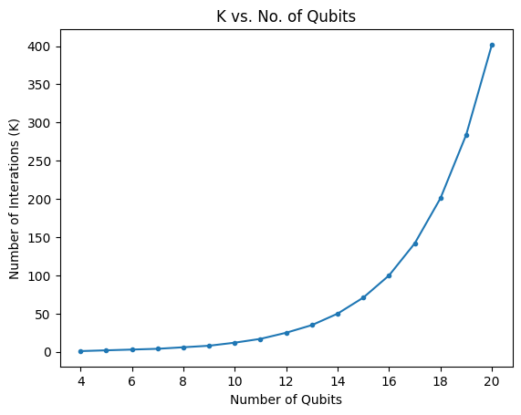
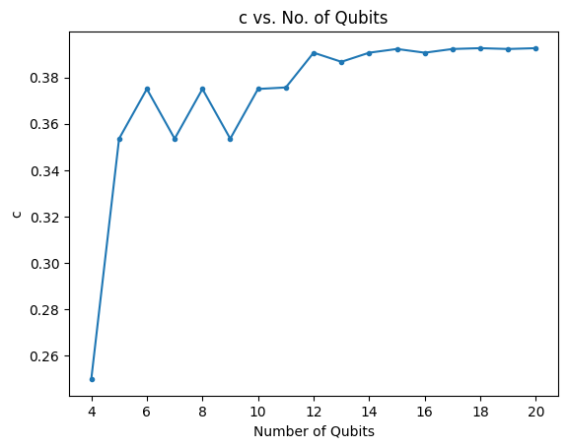
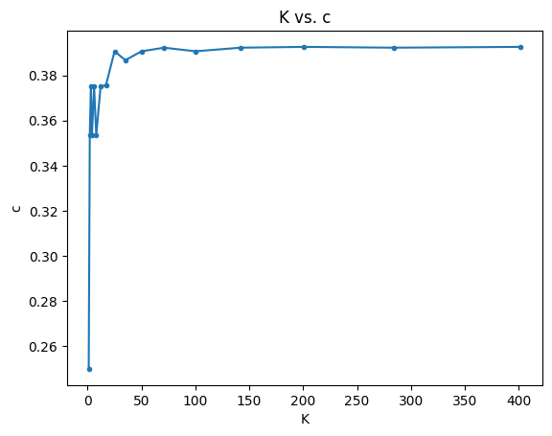
Optimal value of iterations and c in Grover’s
(Sadana 2020, Kaye et. al. 2010)

Slide 9
Optimal value of iterations and c in Grover’s
Not much reliable when N/M quantity is too large!
(Sadana 2020, Kaye et. al. 2010)

Slide 10
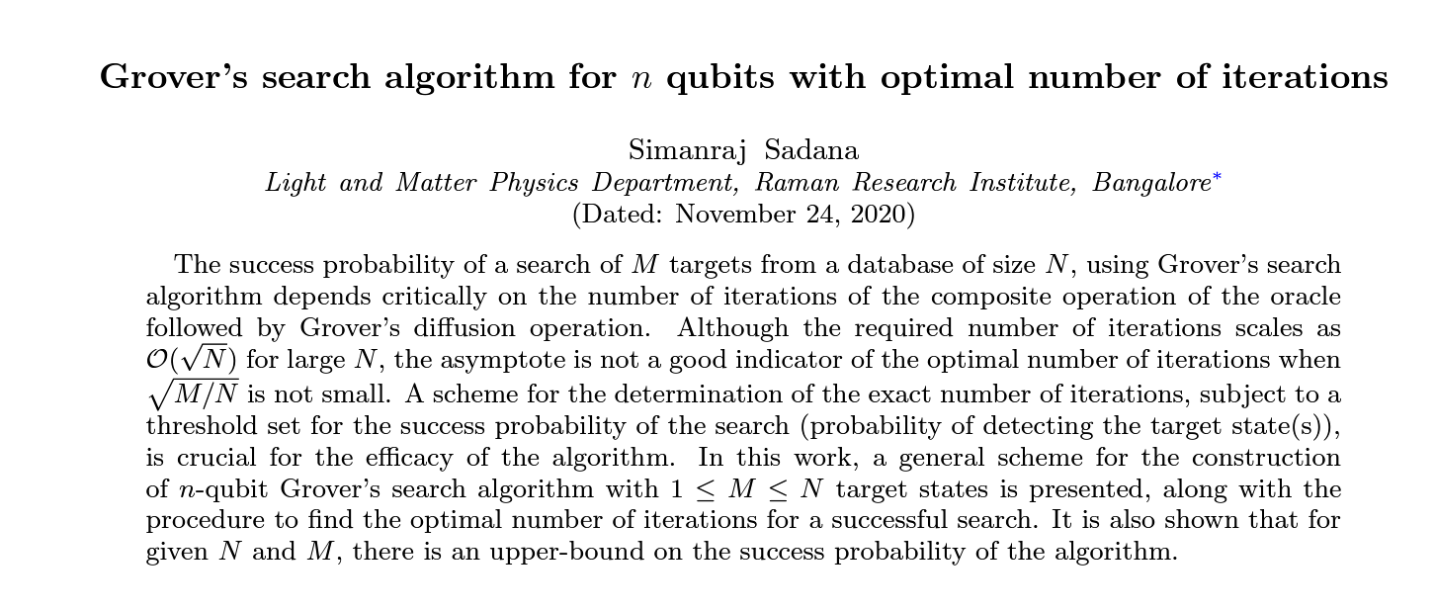
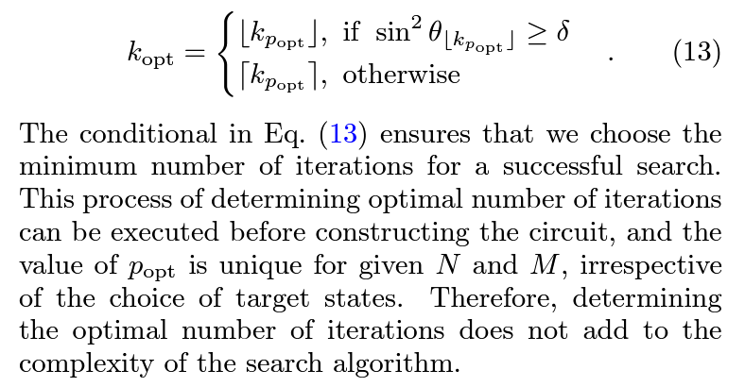
https://doi.org/10.48550/arXiv.2011.04051

Slide 11
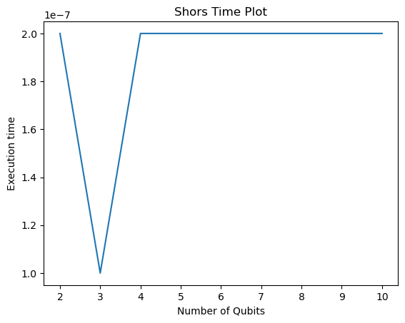
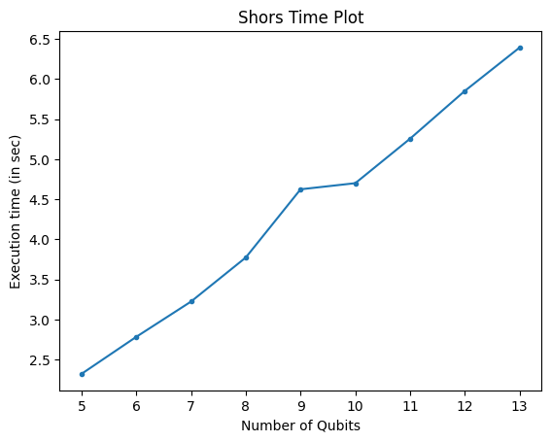
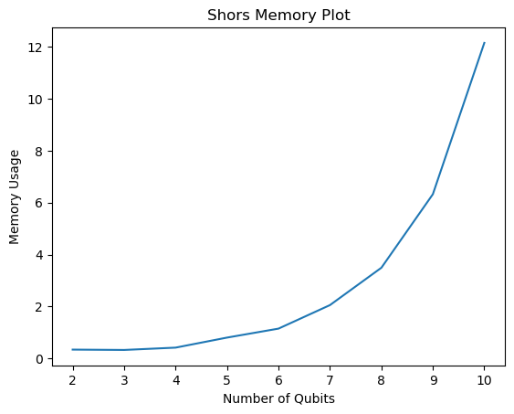
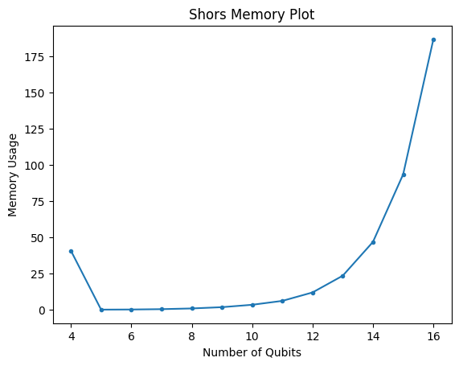
Shor’s Plots
Corrections

Slide 12
Number of Qubits handled by our system
Bernstein-Vazirani : 50+ Qubits 100+ Qubits
Simon’s Algorithm: 8-10 Qubits 100+ Qubits
Grover’s Algorithm : 8-10 Qubits 30+ Qubits
Shor’s Algorithm: 8-10 Qubits 20+ Qubits
Note: We are using 1024 2048 shots for QASM simulator. This significantly impacts the running time of the algorithms.

Slide 13
Thank You!
Pawel Pratyush
Vrushali Shinde
Date: 04 - 13 - 2023

